Slide 1
STARTING SCHOOL
Wraysbury Primary School

Slide 2
To help your child with the transition from home to school, it would be beneficial to work on these skills before he or she starts in September.
We do understand that every child develops at different rates and staff will obviously be there to support the children.
KEY SKILLS TO PRACTISE BEFORE STARTING RECEPTION

Slide 3
HERE ARE OUR TOP
10
SKILLS TO PRACTISE
(IN NO PARTICULAR ORDER)

Slide 4
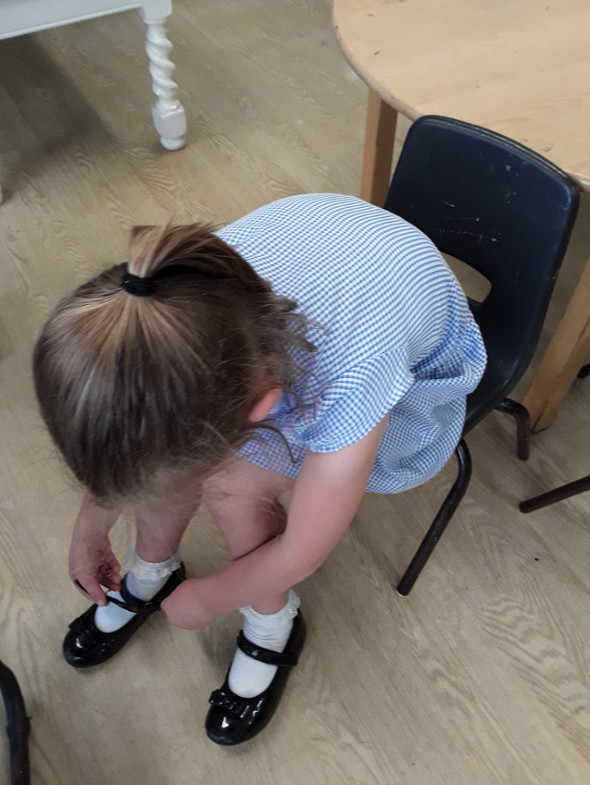
PUTTING ON/TAKING OFF A COAT AND SHOES

Slide 5
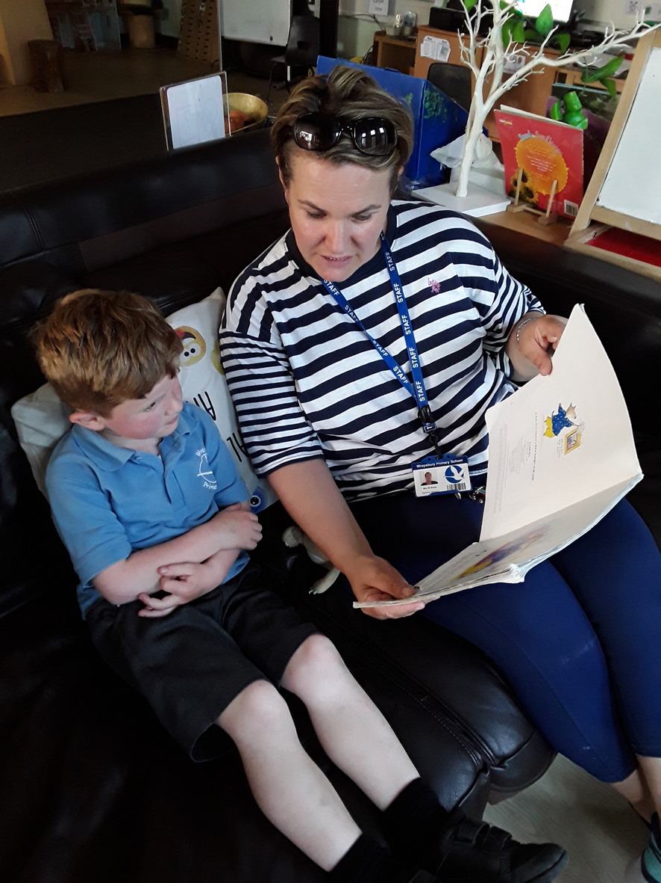
2. LISTENING TO A STORY

Slide 6
3. GOING TO THE TOILET AND WASHING HANDS INDEPENDENTLY

Slide 7
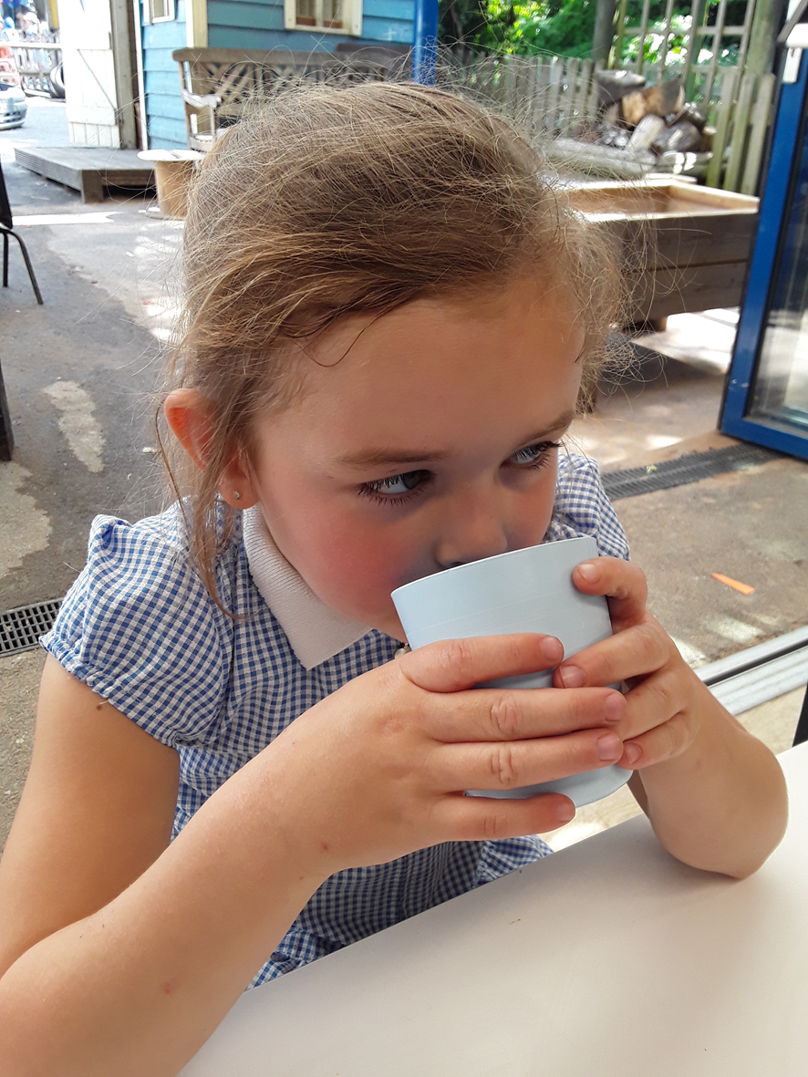
4. DRINKING FROM AN OPEN CUP

Slide 8
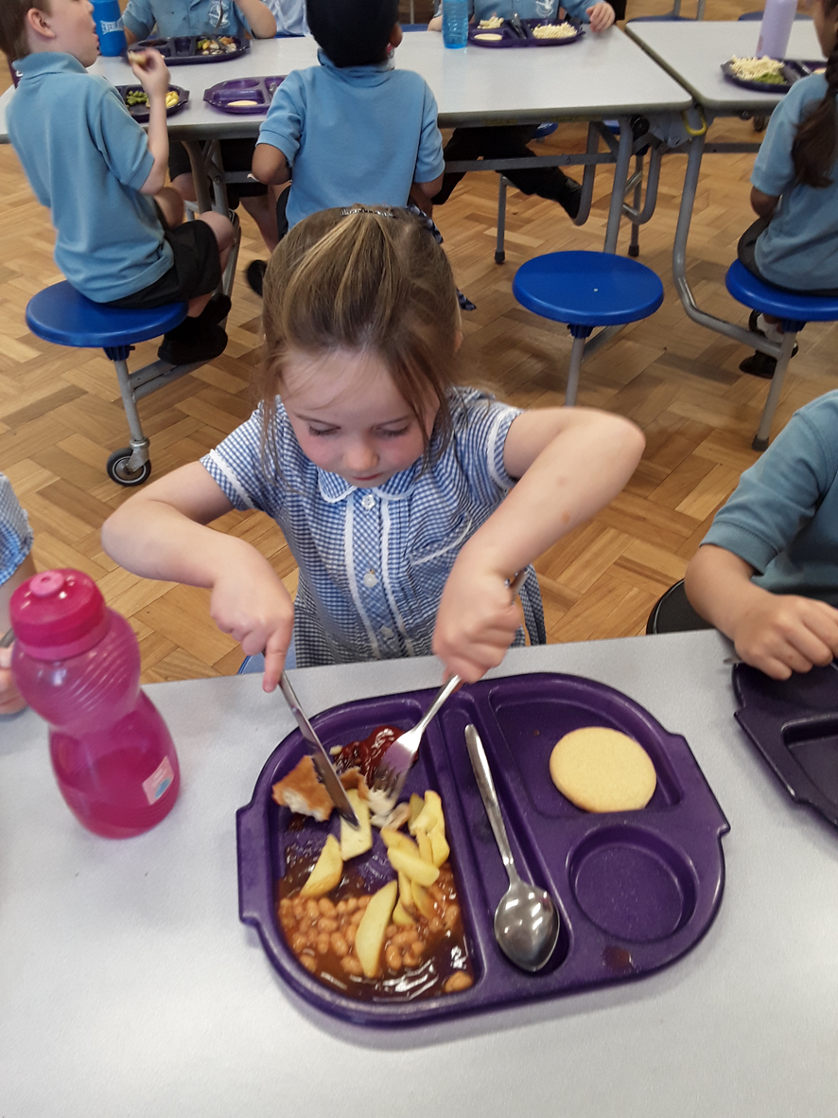
5. USING A KNIFE AND FORK

Slide 9
6. RECOGNISING THEIR OWN NAME

Slide 10
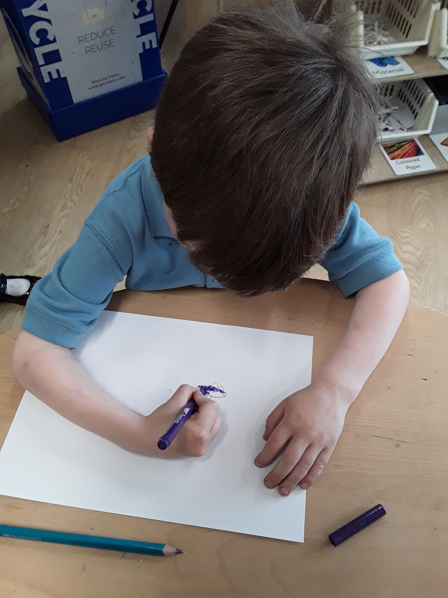
7. DRAWING AND PAINTING

Slide 11
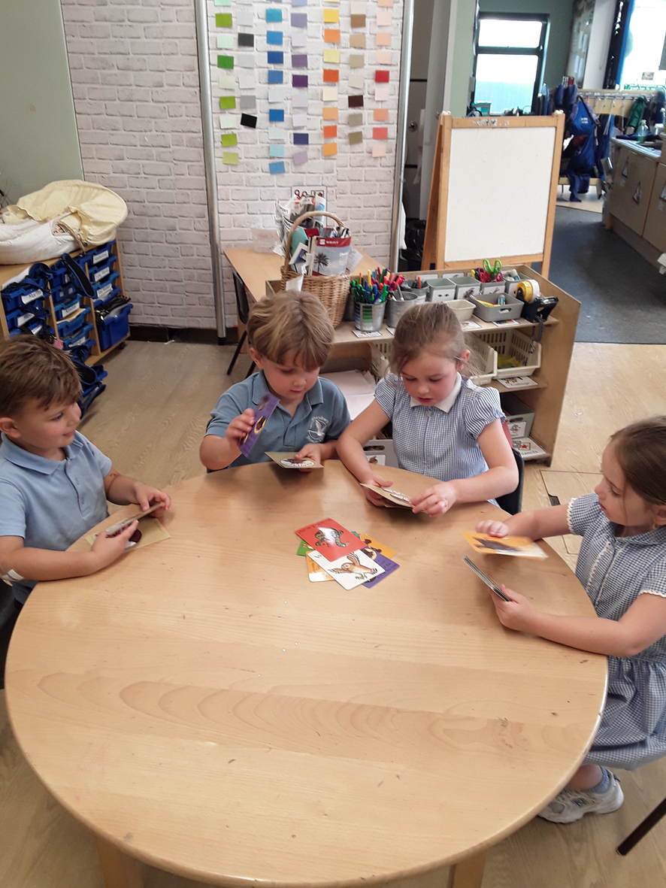
8. TAKING TURNS

Slide 12
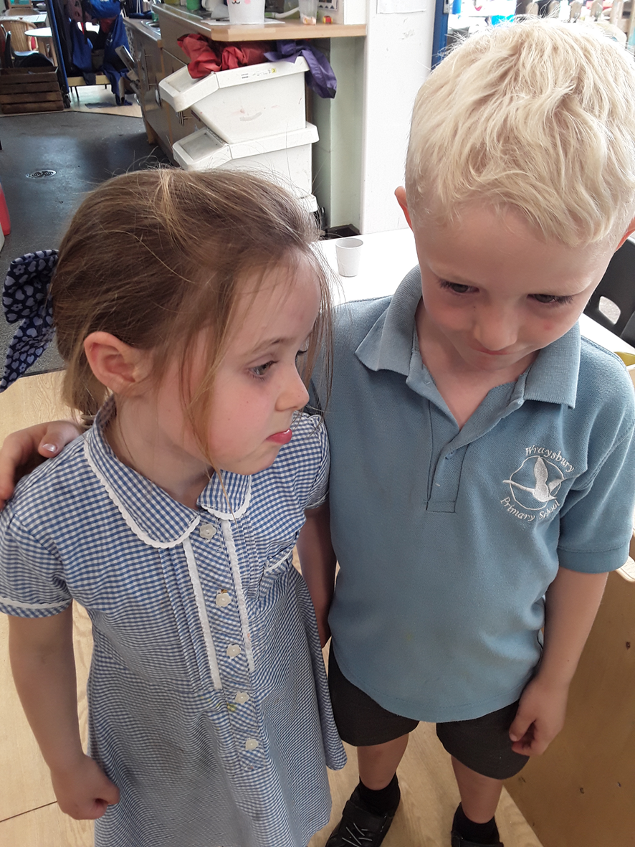
9. IDENTIFYING FEELINGS IN THEMSELVES AND OTHERS

Slide 13
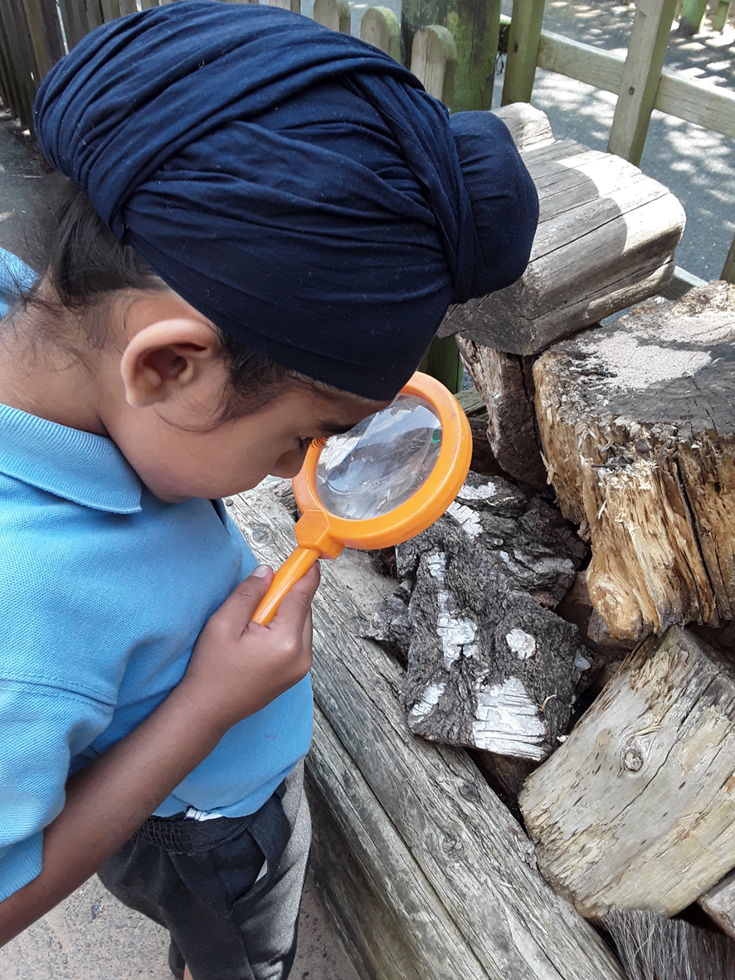
10. SPENDING TIME IN NATURE

Slide 14
We look forward to welcoming you and your child to Wraysbury Primary School in September.

